Slide 1
Data Mining
Association Analysis
Source Courtesy: Some of the contents of this PPT are sourced from materials provided by publishers of prescribed books

Slide 2
Association Rule Generation

Slide 3
Rule Generation
Given a frequent itemset L, find all non-empty subsets f ⊂ L such that f → L – f satisfies the minimum confidence requirement
If {A,B,C,D} is a frequent itemset, candidate rules:
ABC →D, ABD →C, ACD →B, BCD →A, A →BCD, B →ACD, C →ABD, D →ABC AB →CD, AC → BD, AD → BC, BC →AD, BD →AC, CD →AB,
If |L| = k, then there are 2^{k} – 2 candidate association rules (ignoring L → ∅ and ∅ → L)

Slide 4
Rule Generation
How to efficiently generate rules from frequent itemsets?
In general, confidence does not have an anti-monotone property
c(ABC →D) can be larger or smaller than c(AB →D)
But confidence of rules generated from the same itemset has an anti-monotone property
e.g., L = {A,B,C,D}: c(ABC → D) ≥ c(AB → CD) ≥ c(A → BCD)
Confidence is anti-monotone w.r.t. number of items on the RHS of the rule

Slide 5
Rule Generation for Apriori Algorithm
Lattice of rules
Low Confidence Rule
Pruned Rules

Slide 6
Rule Generation with Apriori Algorithm
Candidate rule is generated by merging two rules that share the same prefix in the rule consequent
join(CD=>AB,BD=>AC) would produce the candidate rule D => ABC
Prune rule D=>ABC if its subset AD=>BC does not have high confidence

Slide 7
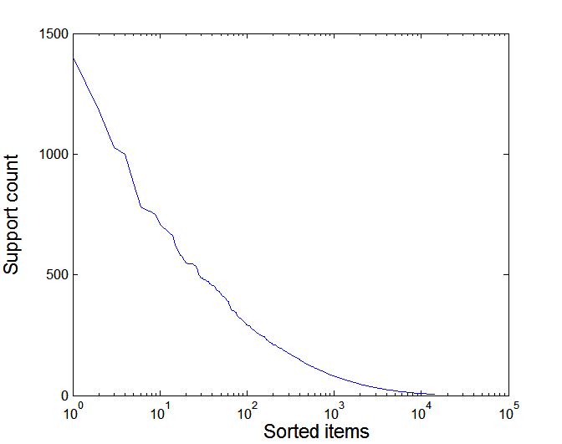
Effect of Support Distribution
Many real data sets have skewed support distribution
Support distribution of a retail data set

Slide 8
Effect of Support Distribution
How to set the appropriate minsup threshold?
If minsup is set too high, we could miss itemsets involving interesting rare items (e.g., expensive products)
If minsup is set too low, it is computationally expensive and the number of itemsets is very large
Using a single minimum support threshold may not be effective

Slide 9
Multiple Minimum Support
How to apply multiple minimum supports?
MS(i): minimum support for item i
e.g.: MS(Milk)=5%, MS(Coke) = 3%, MS(Broccoli)=0.1%, MS(Salmon)=0.5%
MS({Milk, Broccoli}) = min (MS(Milk), MS(Broccoli)) = 0.1%
Challenge: Support is no longer anti-monotone
Suppose: Support(Milk, Coke) = 1.5% and Support(Milk, Coke, Broccoli) = 0.5%
{Milk,Coke} is infrequent but {Milk,Coke,Broccoli} is frequent

Slide 10
Pattern Evaluation
Association rule algorithms tend to produce too many rules
many of them are uninteresting or redundant
Redundant if {A,B,C} → {D} and {A,B} → {D} have same support & confidence
Interestingness measures can be used to prune/rank the derived patterns
In the original formulation of association rules, support & confidence are the only measures used

Slide 11
Computing Interestingness Measure
Given a rule X → Y, information needed to compute rule interestingness can be obtained from a contingency table
Contingency table for X → Y
 | Y | Y
X | f₁₁ | f₁₀ | f₁₊
X | f₀₁ | f₀₀ | f_{o+}
 | f₊₁ | f₊₀ | |T|
f₁₁: support of X and Y f₁₀: support of X and Y f₀₁: support of X and Y f₀₀: support of X and Y
Used to define various measures
support, confidence, lift, Gini, J-measure, etc.

Slide 12
Drawback of Confidence
 | Coffee | Coffee
Tea | 15 | 5 | 20
Tea | 75 | 5 | 80
 | 90 | 10 | 100
Association Rule: Tea → Coffee
Confidence= P(Coffee|Tea) = 0.75
but P(Coffee) = 0.9
Although confidence is high, rule is misleading
P(Coffee|Tea) = 0.9375

Slide 13
Statistical Independence
Population of 1000 students
600 students know how to swim (S)
700 students know how to bike (B)
420 students know how to swim and bike (S,B)
P(S∧B) = 420/1000 = 0.42
P(S) × P(B) = 0.6 × 0.7 = 0.42
P(S∧B) = P(S) × P(B) => Statistical independence
P(S∧B) > P(S) × P(B) => Positively correlated
P(S∧B) < P(S) × P(B) => Negatively correlated

Slide 14
Statistical-based Measures
Measures that take into account statistical dependence

Slide 15
Example: Lift/Interest
 | Coffee | Coffee
Tea | 15 | 5 | 20
Tea | 75 | 5 | 80
 | 90 | 10 | 100
Association Rule: Tea → Coffee
Confidence= P(Coffee|Tea) = 0.75
but P(Coffee) = 0.9
Lift = 0.75/0.9= 0.8333 (< 1, therefore is negatively associated)

Slide 16
Drawback of Lift & Interest
 | Y | Y
X | 10 | 0 | 10
X | 0 | 90 | 90
 | 10 | 90 | 100
 | Y | Y
X | 90 | 0 | 90
X | 0 | 10 | 10
 | 90 | 10 | 100
Statistical independence:
If P(X,Y)=P(X)P(Y) => Lift = 1

Slide 17
Subjective Interestingness Measure
Objective measure:
Rank patterns based on statistics computed from data
e.g., many measures of association (support, confidence, Laplace, Gini, mutual information, Jaccard, etc).
Subjective measure:
Rank patterns according to user’s interpretation
A pattern is subjectively interesting if it contradicts the expectation of a user
A pattern is subjectively interesting if it is actionable

Slide 18
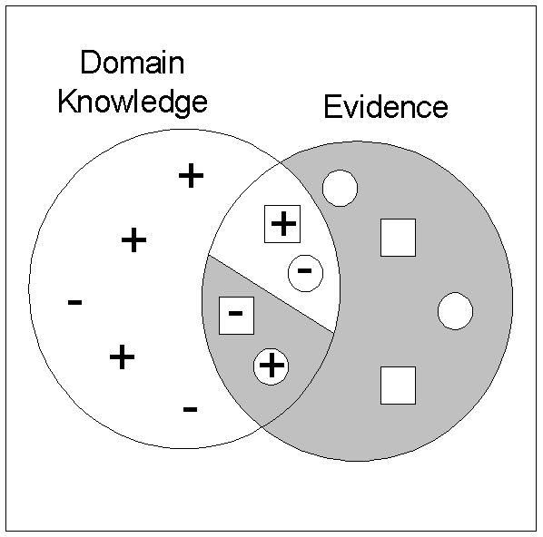
Interestingness via Unexpectedness
Need to model expectation of users (domain knowledge)
Need to combine expectation of users with evidence from data (i.e., extracted patterns)
+
Pattern expected to be frequent
-
Pattern expected to be infrequent
Pattern found to be frequent
Pattern found to be infrequent
+
-
Expected Patterns
-
+
Unexpected Patterns

Slide 19
Review

Slide 20
Data Mining
Draws ideas from machine learning/AI, pattern recognition, statistics, and database systems
Traditional Techniques may be unsuitable due to
Enormity of data
High dimensionality of data
Heterogeneous, distributed nature of data
Statistics/ AI
Machine Learning/
Pattern Recognition
Data Mining
Database systems

Slide 21
Major Tasks in Data Preprocessing
Data cleaning
Fill in missing values, smooth noisy data, identify or remove outliers, and resolve inconsistencies
Data integration
Integration of multiple databases, data cubes, or files
Data reduction
Dimensionality reduction
Numerosity reduction
Data compression
Data transformation and data discretization
Normalization
Concept hierarchy generation

Slide 22
Basic Statistical Descriptions of Data
Motivation
To better understand the data: central tendency, variation and spread
Data dispersion characteristics
median, max, min, quantiles, outliers, variance, etc.
Numerical dimensions correspond to sorted intervals
Data dispersion: analyzed with multiple granularities of precision
Boxplot or quantile analysis on sorted intervals
Dispersion analysis on computed measures
Folding measures into numerical dimensions
Boxplot or quantile analysis on the transformed cube
Notes:
Note to self (MK): last part of slide does not clearly match slides that follow
Introduction slides:
In the current version, we only talk about numeric data. Can we add some materials about non-numeric data.
- text statistics, TF/IDF
- visualization of text statistics such as word cloud
- distribution of Internet (IN, SCC, OUT, …)
- visualization of social relationship (e.g., http://renlifang.msra.cn/)

Slide 23
Classification
Classification
predicts categorical class labels (discrete or nominal)
classifies data (constructs a model) based on the training set and the values (class labels) in a classifying attribute and uses it in classifying new data
Prediction
models continuous-valued functions, i.e., predicts unknown or missing values
Decision Tree based Methods
Rule-based Methods
Neural Networks
computational networks that simulate the decision process in neurons (networks of nerve cell)
Naïve Bayes and Bayesian Belief Networks
uses the probability theory to find the most likely of the possible classifications
Support Vector Machines
fits a boundary to a region of points that are all alike; uses the boundary to classify a new point

Slide 24
Better Frequent-pattern Mining
Multiple database scans are costly
Mining long patterns needs many passes of scanning and generates lots of candidates
To find frequent itemset i₁i₂…i₁₀₀
# of scans: 100
# of Candidates: (₁₀₀¹) + (₁₀₀²) + … + (₁¹₀⁰₀⁰) = 2¹⁰⁰-1 = 1.27*10³⁰ !
Bottleneck: candidate-generation-and-test
Can we avoid candidate generation?
Use a compressed representation of the database using an FP-tree
Once an FP-tree has been constructed, it uses a recursive divide-and-conquer approach to mine the frequent itemsets
Scan DB once, find frequent 1-itemset (single item pattern)
Sort frequent items in frequency descending order, f-list
Scan DB again, construct FP-tree

Slide 25
Discussions
Problems
Concepts

Slide 26
Prescribed Text Books
 | Author(s), Title, Edition, Publishing House
T1 | Tan P. N., Steinbach M & Kumar V. “Introduction to Data Mining” Pearson Education
T2 | Data Mining: Concepts and Techniques, Third Edition by Jiawei Han, Micheline Kamber and Jian Pei Morgan Kaufmann Publishers
R1 | Predictive Analytics and Data Mining: Concepts and Practice with RapidMiner by Vijay Kotu and Bala Deshpande Morgan Kaufmann Publishers
R2 | Oracle Documentation (http://docs.oracle.com/cd/B28359_01/datamine.111/b28129/regress.htm)

